Slide 1
CS 360 Presentation: NoDD Grading Oct. 18 NoDD
Andrew Plum and Nathan Nguyen
plum0598@vandals.uidaho.edu
nguy7866@vandals.uidaho.edu

Slide 2
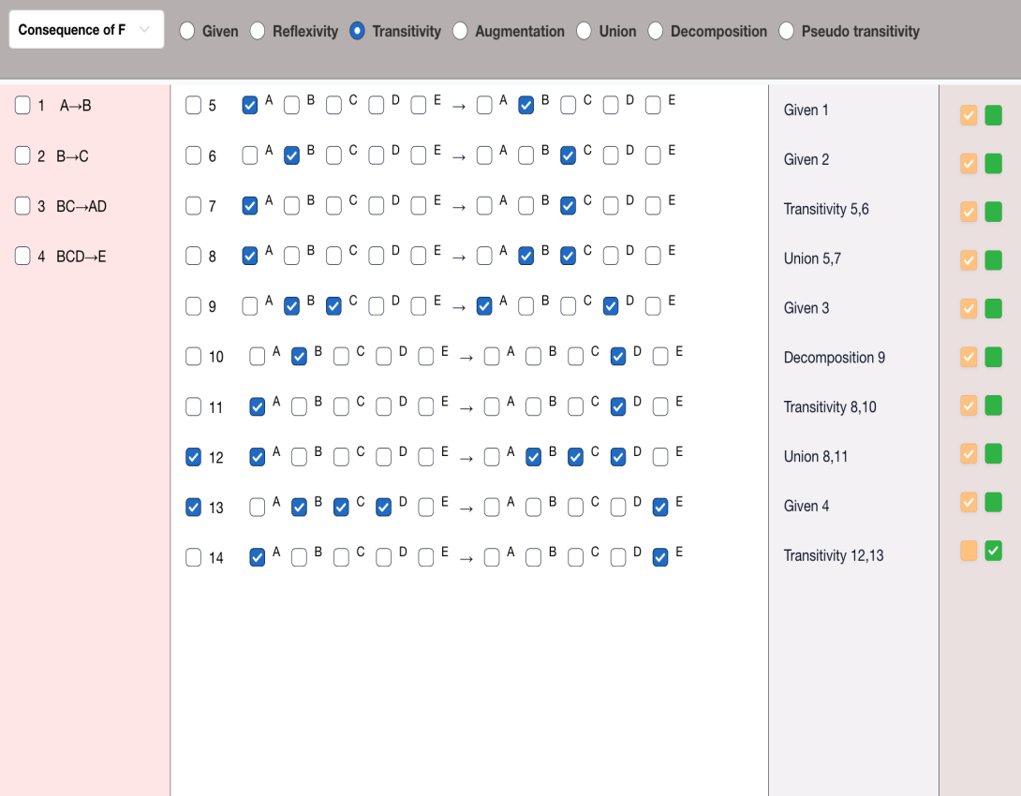
NoDD Grading
Existing User Interface:
Grade student response for:
Logical Consequence of F
Attribute Closure
Candidate Keys
We are supplied the data, and our work is to evaluate the student submission
Entirely backend work

Slide 3
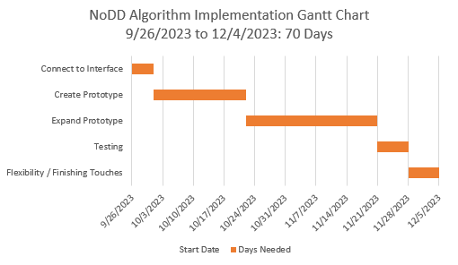
Schedule
On track to meet the deadlines we created.
Slight setbacks
Useless interface
Brainstorming time
F*
Currently working on:
Integrating algorithms with main
Database
Testing

Slide 4
Logical Consequence of F
Check to see if each step on its own is correct
Check to see if student reached the correct answer
Check the last step
How we did it
Applied the definitions to the relevant data for the six inference rules
We did complete this

Slide 5
Attribute Closure
After applying the inference rule definitions for the code in evaluating the student response for the logical consequence of F, we applied all to make a function which determines if step was applicable to one of the 6 inference rules
From here we realized that we could slightly modify this code to make it validate the student’s attribute closure submission.
Check if the jump from step to step is correct
Check if final result that should be calculated is reached
This is working

Slide 6
Candidate Keys
Build on what we have for attribute closure
If the set of attributes can derive all attributes then it is a super key
If it is a minimal super key, then it is a candidate key
Check if the jump from step to step is correct
Check if all candidate keys that were found matches all candidate keys that should be found based on the initial sets of attributes inputted
We calculate the keys that should be found exhaustively and heuristically depending on the question type

Slide 7
To Do
Get candidate key methods fully working
Testing

Slide 8
Let’s Look at the Project
Testing demonstration page as well as source code located here:
https://github.com/NLedge/NoDDx/tree/main
Project 360 NoDD:
https://project360.smartdblab.org/tools/fd/nodd
Design questions for you:
For the candidate key methods, the interface only ever shows the first possible combination of attributes. Can only check for up to first combination.
If a student marks a set of attributes as a candidate key, should they also mark it as a super key on the interface (this is what would be correct but saying it is a candidate key implies it is a super key)
Test input file

